Slide 1
Welcome to Optimization
Michael Watson
Ehsan Khodabandeh

Slide 2
Welcome!
Introductions
Class Logistics
Combination of lectures, discussions, and in-class exercises
There is always room for questions, comments, and relating your experiences
Please keep us posted (with at least an e-mail) with any attendance problems
If you use a laptop, just use for notes or exercises– distracting to those behind you and obvious to us
Homework Tips
Don’t expect the workload to be evenly distributed- there is too much of a mix
Better homework assignments:
Are clear, concise, and well-written
Are “correct”– units match up, answers make intuitive sense
We treat going over the homework like a lecture– bring notes on what you did, questions you may have had, and extensions of the assignment. You can learn a lot from this
Homework groups: We’ll assign and switch up periodically
We like to go fast and cover a lot- feel free to ask questions
The more you put into the class, the more you will get out of it

Slide 3
Course Overview
Optimization Overview. What is it? Why is It Important?
Linear Programming. The quintessential optimization technique
Integer Programming. Creating more realistic (but harder to solve) models
Heuristics.
Practical. We want you to use this. It applies to many organizations. This course will cover a lot of applications. We are not going deep on theory.
Hands-On. Learn to write and understand models. Build intuition

Slide 4
Optimization Overview
What is it? Why is It Important?

Slide 5
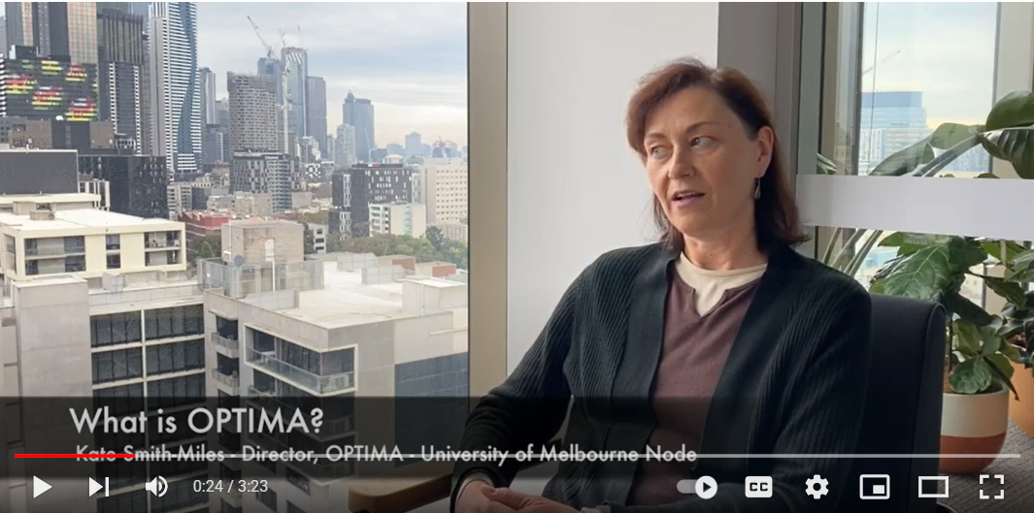
What is Optimization? Why Important?
What did you take away from the first two minutes of the video?
Make better decisions / come up with better solutions
Everyone has these problems (whether they know it or not)
Helps manage scarce resources
Schedules people, facilities, combinations (like surgeries), designs products and processes
Has multiple objectives
Would like to see industry uptake (this is what we want you to do! Use this!)
Anyone watch the last minute?
My take-away: it can be hard!
My take-away for you: we want you to spot the problems, solve the easier ones and know how to figure out the more complex

Slide 6


What is Optimization?
Slick Oil Co – Distribution Problem
They have turned to YOU for advice!
Slick recently signed on a new large customer
The customer has committed to purchasing 100,000 barrels of oil over the next year
After celebrating the deal, Slick now needs to choose which wells and refineries they will use to satisfy this new customer’s demand
All their potential wells and refineries are already built and ready to be used so no fixed cost will apply (we assume this is sunk)
Each well and refinery has its own cost per barrel and capacity
Not all refineries have the ability to receive oil from all wells
All refineries ARE able to service this new customer location though

Slide 7
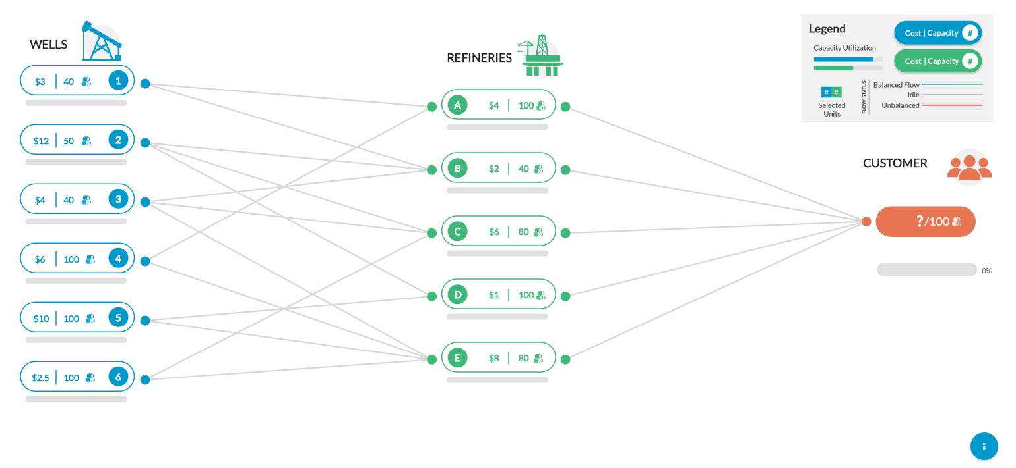
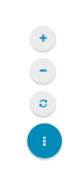
We used to have a cool on-line version.
Slick Oil Game
Zoom In/Out for best fit to Screen
must ship 100 barrels to customer
Reset the Game
can only ship on designated lanes

Slide 8
Slick Oil Game- Zoomed In

Slide 9
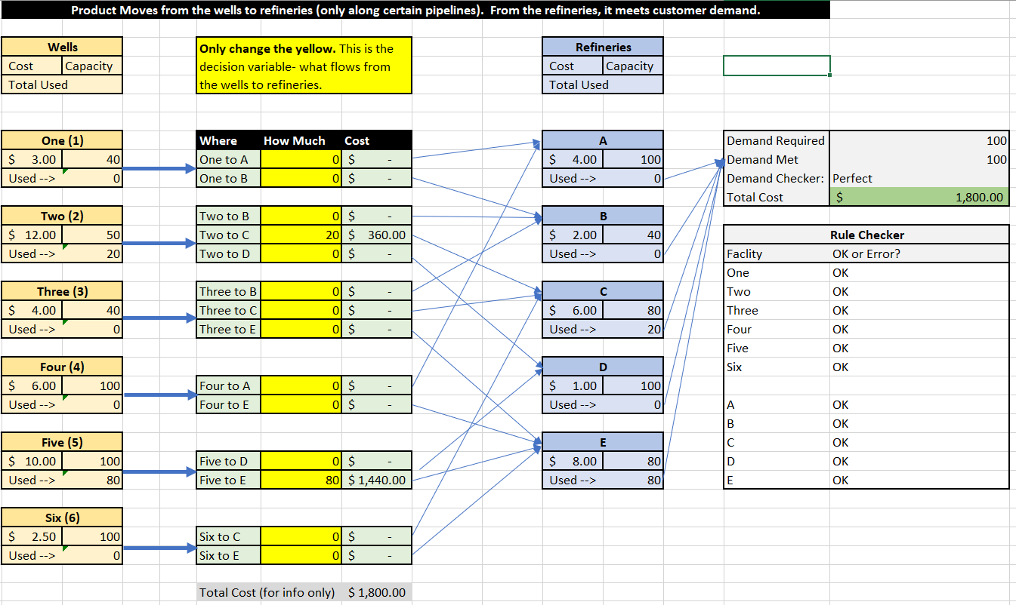
For now, we’ll use an Excel Replica

Slide 10
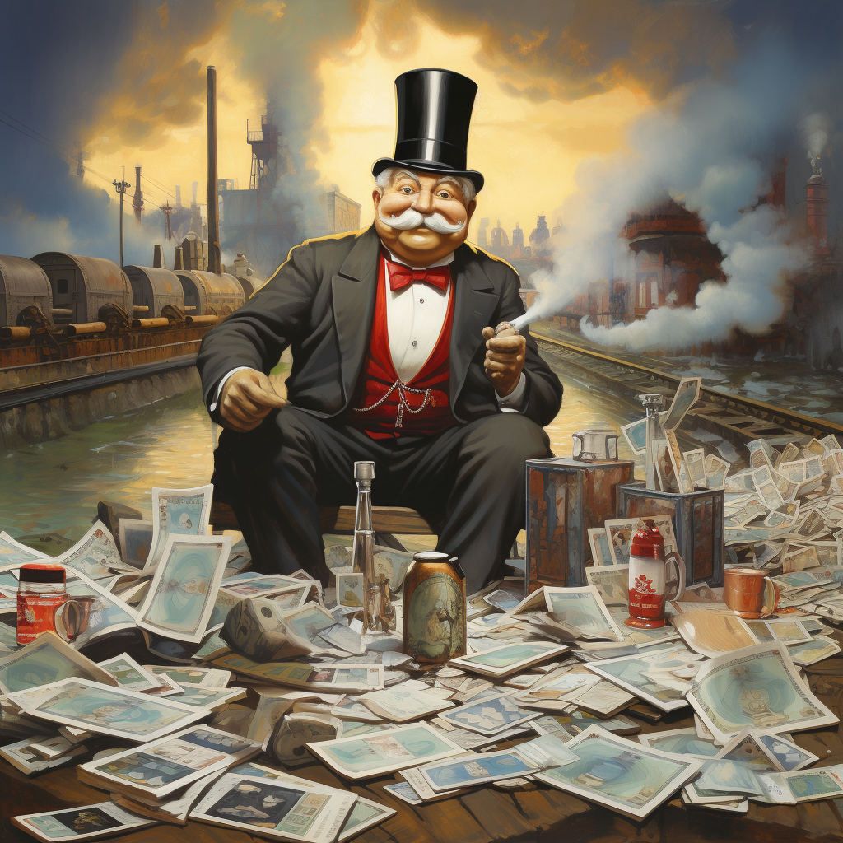
Here’s a solution the guy on the right would like you to implement…

Slide 11
You can do better! What is Optimization?
Slick Oil Game- Scenarios to Test
Easy solution with sites that can meet 100 units of demand
Cheapest Well, followed by cheapest Refinery
Cheapest Refinery, followed by cheapest Well
Cheapest Combo of Well and Refinery
Can you do better???

Slide 12
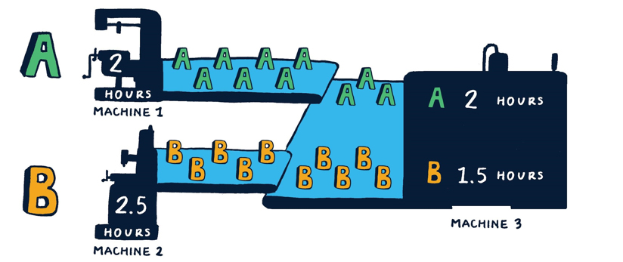
Model Two: Another Simple Factory
Makes 2 products, A and B
3 Machines
A and B share Machine 3
21 days/ month x 16 hours/day
Our Mission:
From an Accounting point of view:
What product is most profitable?
What should the plan be?
Can you do better? Why?

Slide 13
Cheapest Airline Ticket from Chicago to NY?
Ticket Prices:
Airline 1: $250
Airline 2: $225
Airline 3: $205
Airline 4: $275
Airline 5: $230
What is the best strategy?
What if you were doing this for a product sold at 1000s of retailers?
Lesson: If you can sort and pick the best, you don’t need other technology

Slide 14
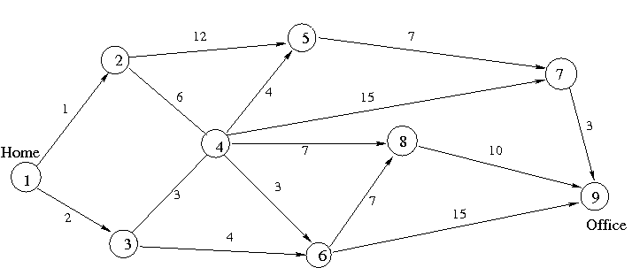
What is the Shortest Path from 1 (Home) to 9 (Office)?
What was your approach?
Enumeration?
What is the “greedy” approach? Where does it fail?

Slide 15
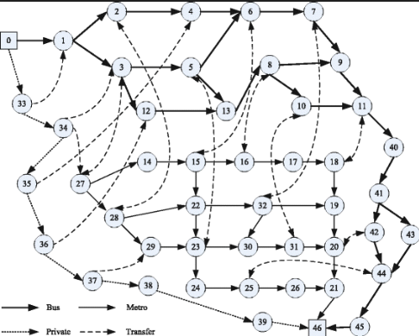
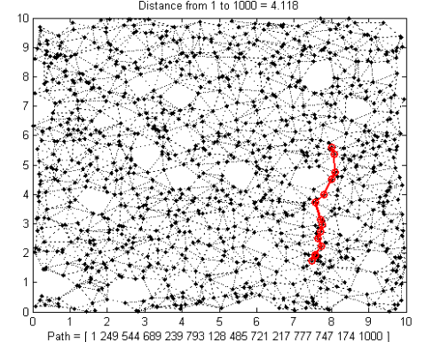
Enumeration Can Get Hard Fast

Slide 16
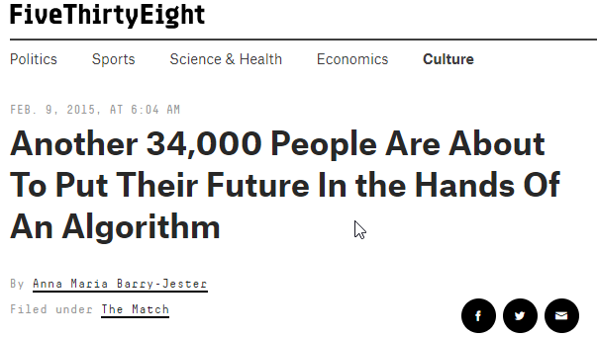

Even Matching is Hard… Residency
Source: https://fivethirtyeight.com/features/another-34000-people-are-about-to-put-their-future-in-the-hands-of-an-algorithm/

Slide 17
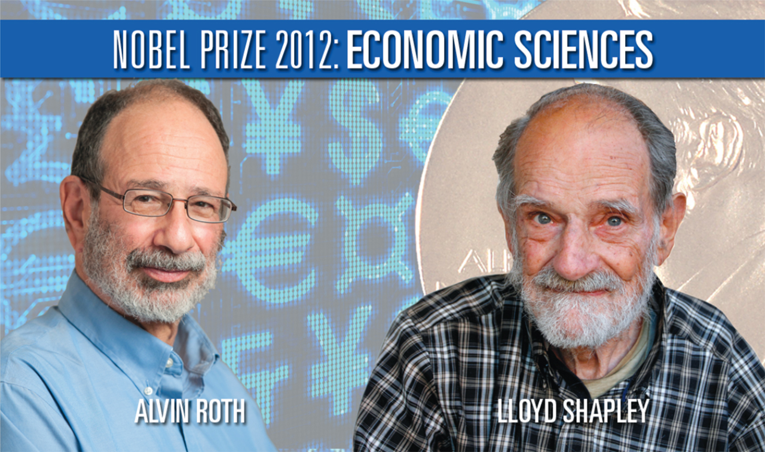
Even Matching is Hard… Residency
Built a nice algorithm for this matching.
Algorithm broke in recent decades:
Many more couples are graduating together and must be in the same city (and they have different preferences). He says 2K of the 19K graduates are couples.
I heard a talk from Alvin Roth. He won a Nobel Prize for this type of work.
Fun fact from the talk: They realized that the interview process was not great. Hi peers were saying, “who cares, that is their problem, our algorithm works.”
Roth took a different approach: We have to figure out how to help with the interview so they can use the algorithm and the market can work!
Key condition is market stability– no one can gain from a trade (source). (After doing the matching, no doctor or hospital are better off by agreeing to work together and ignoring the match they each got.

Slide 18
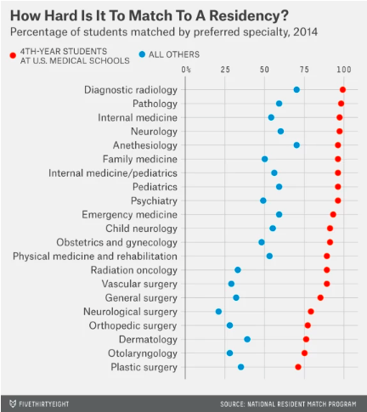
Even Matching is Hard… Residency

Slide 19
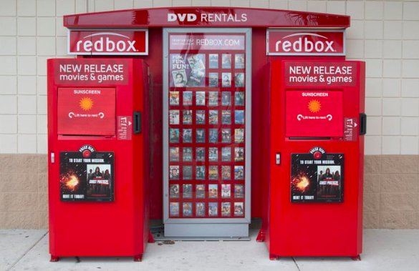
How Does Optimization Compliment Prediction?
Optimization Problem?:
Prediction Problem: What will be the demand for a new movie or game at a particular location?
Prediction shows demand of 100K units, you physically have 25K units to distribute. How do you allocate those units?

Slide 20

How Does Optimization Compliment Prediction? Beauty Catalog
Prediction Problem: predict demand for a product on a given page for a certain price (and maybe in relation to other products)
Optimization Problem?:
Each ad can only be placed once (it has predictions for every page). Actually good for automation too!

Slide 21
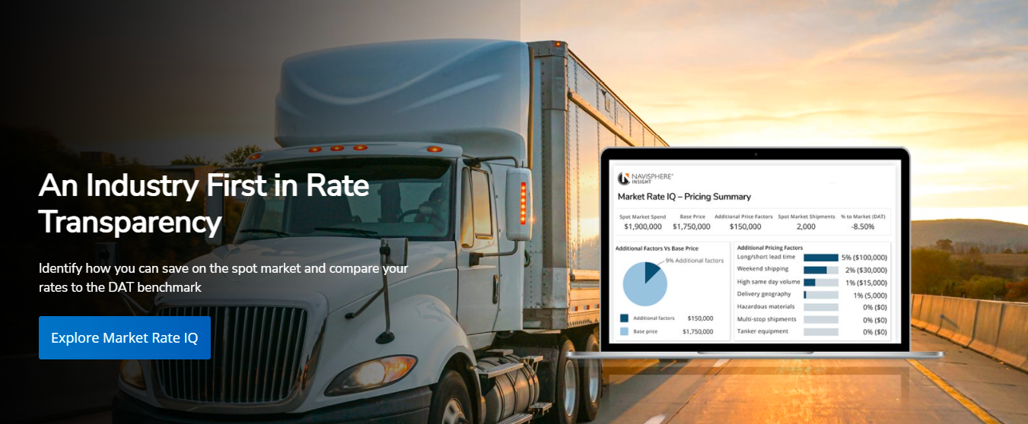

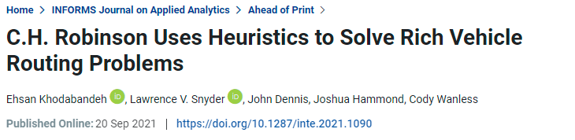
Optimization to Create Customer Engagement
Challenges:
Revenue Benefits:
105,000 Customers
73,000 Carriers
200,000 (and growing) loads per year
Many constraints and rules for the routes
“Optimizer capabilities has helped us secure several large customer opportunities…”
The technical capability helps increase customer engagement

Slide 22

How would you schedule nurses at a large hospital?
Sort (like the airline pricing example)?
Enumerate (like the shortest path problem)?
Tweak results to find a good solution (like our machine scheduling problem)?

Slide 23
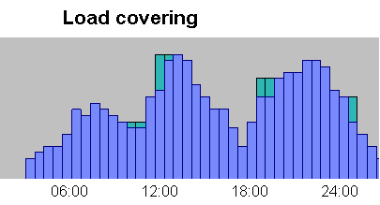
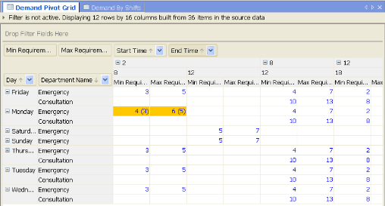
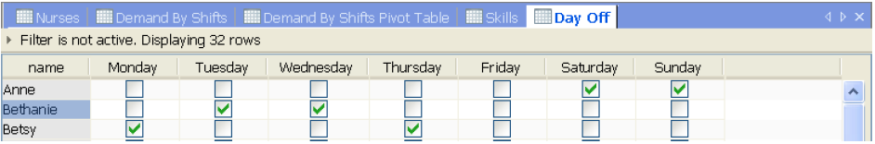
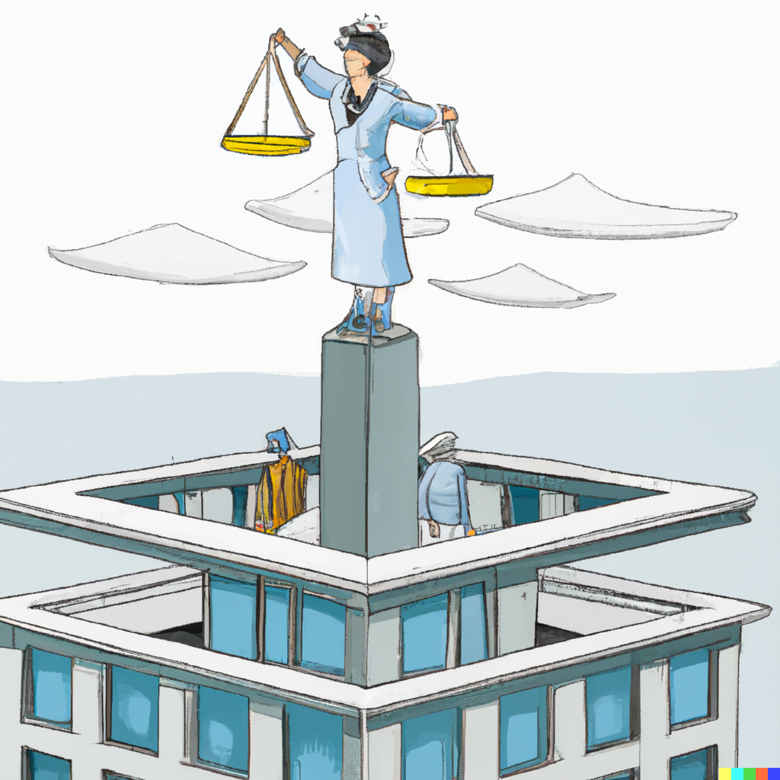
Why is it Difficult to Schedule Nurses at a Large Hospital?
Demand for nurses with various skills can vary by time of day and by department
Nurses have various skills, different pay rates, different availability for work
There are many different rules and regulations– number of hours worked, time off, who can work together, stability of schedule, etc
There are many objectives to balance– minimizing cost, maximizing service, maintaining a satisfied nurse staff (through good and fair scheduling)
Creating schedules manually is time consuming and tedious– and stills creates poor schedules. Using simple automated rules can quickly lead to bad schedules. Optimization technology can sort through all possibilities and return good solutions

Slide 24

What Would be the Benefits of Good Scheduling?
Reduced costs
Less costs through better schedules
Less costs through less time making schedules
More time to focus on patient care
Managing nurses spend less time on the schedule
Better patient care
Better schedules lead to ensuring that the right skills are available when and where needed
Better schedules ensure that the right team of nurses are assembled
More satisfied nurses
Better ability to adhere to the various rules and preferences of the nurse

Slide 25
NBC– Selling TV Ads
60-80% of all Ad space sold in a 3-week period in May for the upcoming season
What the advertisers want
Stay within budget
Total number of impressions by demographic
Weekly mix
Program length
Unit-length distributions (30, 60, 120, 15, or 10 seconds)
What NBC wants
Meet as much of the client’s desired plan as possible
Minimize the amount of premium inventory sold
Create a plan that works (Why is this hard??)
Result: $200M in extra revenue
And, a more productive sales force

Slide 26
Kidney Donation
If a person needs a kidney transplant…
Kidney transplant from a live person lasts about 16 ½ years versus 8 ½ years if from a deceased person
3-5 years waiting for a deceased person’s kidney
Person lives 10 years longer with a transplant than if you stay on dialysis
Healthy people only need 1 kidney, but can only be a donor if…
The blood types are compatible
There are no other antibodies in the blood that make it incompatible
How do you solve this problem?
Donor A
X
Recpt A
Source: http://rcdn-3.brainsonic.com/c1/cdn/3/customers/ilog/20090203_dialog09/large_player/d2_r2_7.html

Slide 27
Kidney Donation
If a person needs a kidney transplant…
Kidney transplant from a live person lasts about 16 ½ years versus 8 ½ years if from a deceased person
3-5 years waiting for a deceased person’s kidney
Person lives 10 years longer with a transplant than if you stay on dialysis
Healthy people only need 1 kidney, but can only be a donor if…
The blood types are compatible
There are no other antibodies in the blood that make it incompatible
Donor A
X
Recpt A
Donor B
X
Recpt B

Slide 28
Kidney Compatibility is Only One Factor
Wait time
Distance
Recipient vs Donor Age Disparity
Donor vs Donor Age Disparity
Pediatric Bonus
Other chemical/blood compatibility issues

Slide 29
Creating Kidney Swaps
1
8
2
7
3
6
4
5

Slide 30
Creating Kidney Swaps
5 pts
1
1
8
2
8
2
5 pts
20 pts
7
3
7
3
20 pts
20 pts
6
20 pts
4
6
20 pts
4
5
5
4 Matches- 50 Points
3 Matches- 60 Points
Don’t give your reasons….
What solution is better?
I’m going to give you no more information

Slide 31
Creating Kidney Swaps
5 pts
1
1
8
2
8
2
5 pts
20 pts
7
3
7
3
20 pts
20 pts
6
20 pts
4
6
20 pts
4
5
5
4 Matches- 50 Points
3 Matches- 60 Points
What if “8” is 20-year donor with her 50 year old dad, and “3” is 53 year old dad donating to his 24 year old daughter and they match on many categories? Likewise, “1” and “2” were both couples in their late 70’s with poor matches in other categories.
Now which solution is better?

Slide 32
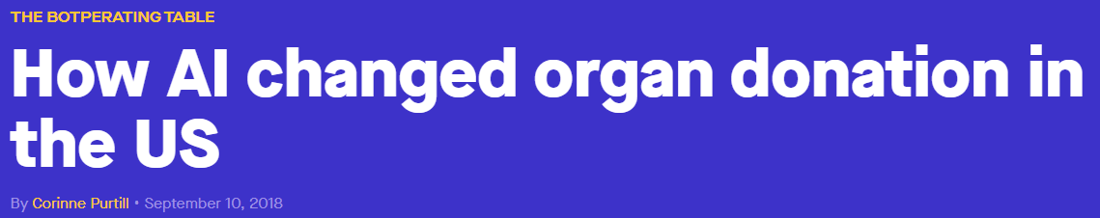

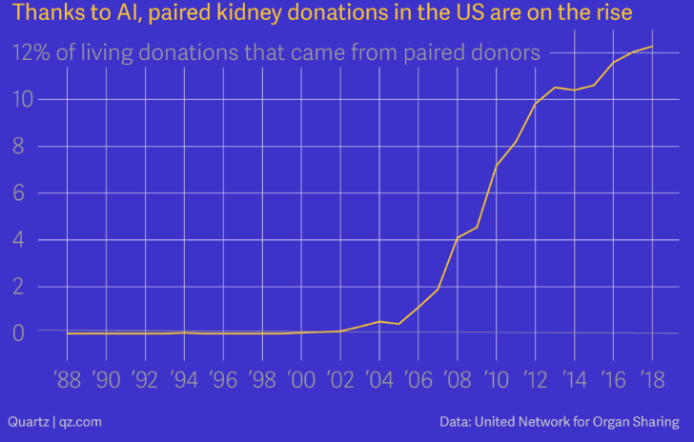
Recent Article on Kidney Exchange
Source:
https://qz.com/1383083/how-ai-changed-organ-donation-in-the-us/

Slide 33
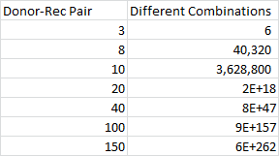
Given you have an objective, what makes optimization hard?
1
8
2
7
3
6
4
5
Problem grows N!

Slide 34
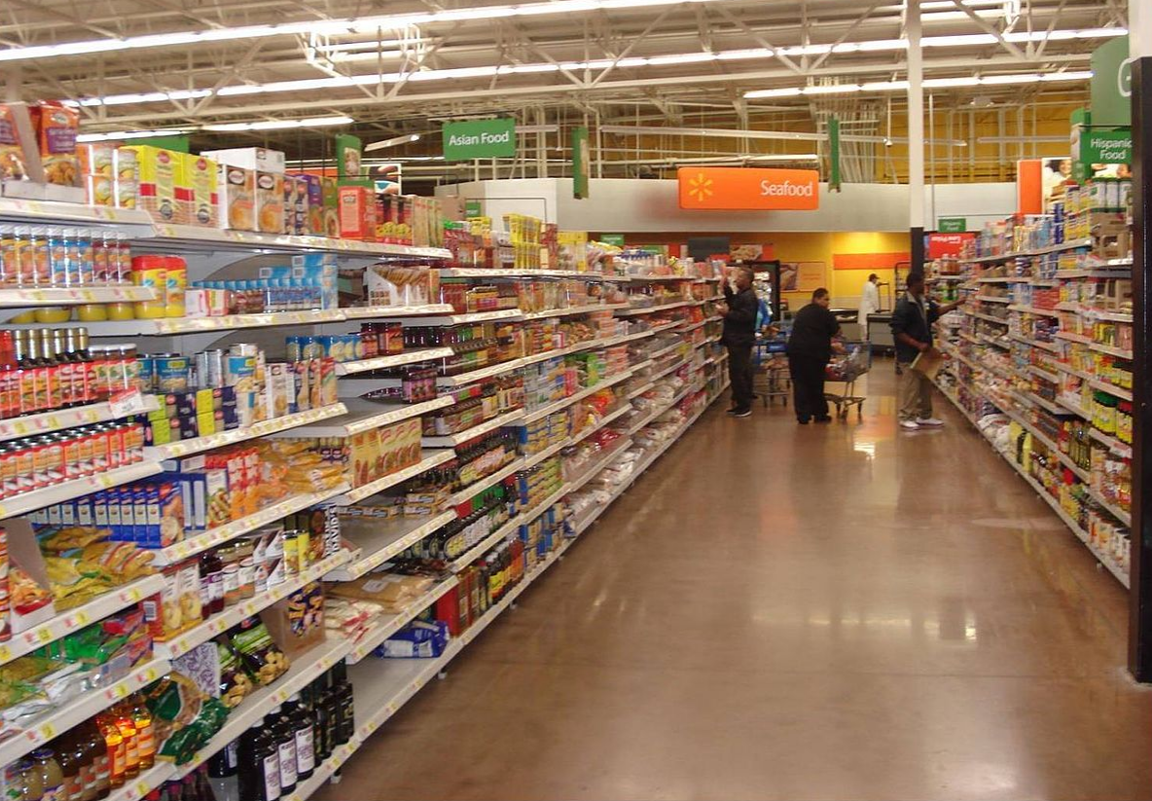
Have You Ever Wondered How Stores Decide Where to Put Items?

Slide 35
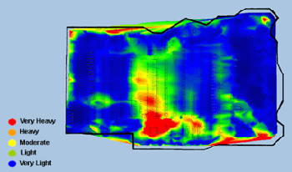
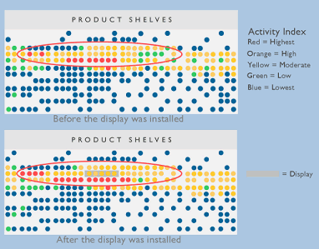
Retailers Understand Where Shoppers Are and Where They Buy
Heat Maps Track Where Customers Spend Time
Heat Maps Can Track Impact of Changes to the Store
Kroger's is merging heat maps of where people spend time and where they spend money
Source: maps from TNS-Sorenson

Slide 36
Optimization Can Help Determine Where To Put Categories
1
2
3
4
5
6
7
8
9
10
C1
C3
C5
C4
C2
Store Traffic
11
12
13
14
15
16
17
18
19
20
Product Category | Quantity | Location
C1 | 300 | 1
C2 | 500 | 9, 10
C3 | 1000 | 2-6
C4 | 300 | 8
C5 | 200 | 7
… | … | …
The system then decides product category quantities and locations; In larger stores, it also is considering what categories go next to each other
Source: IBM

Slide 37

Optimization Can Determine Where Product Goes on the Shelf
1
2
3
4
5
6
7
8
9
10
C1
C3
C5
C4
C2
You now want to lay out the items on the shelf and develop a detailed planogram
High
A
E
C
H
Eye Level
B
D
F
I
K
J
I
L
M
Low
Source: IBM

Slide 38
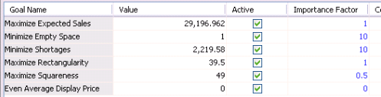
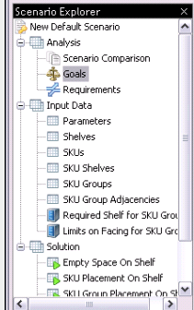
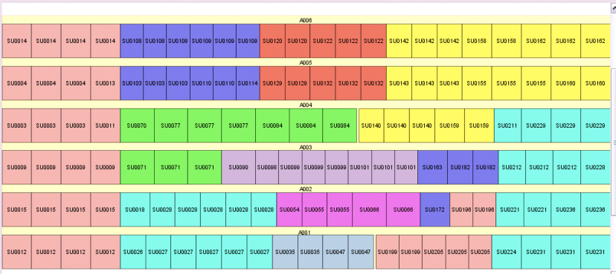
What Goes Into the Optimization?
1. Solution is driven by many conflicting goals with different importance.
2. Detailed inputs describe expected sales, SKU sizes, shelf and floor space requirements.
3. Solution shows the layout of the SKU’s on the shelf, colored by family. Many options for visualizing the display
Source: IBM

Slide 39
What Other Special Considerations Go Into the Optimization?
It is clear you have many objectives…
What are these?
Keep families of products together
Keep brands together
Keep store brands near manufacturers brands
Reserve certain space for manufacturers
Lesson: Optimization can be very literal. Said differently: you can guide the results with clever modeling– there is a lot of art in optimization
Source: IBM

Slide 40
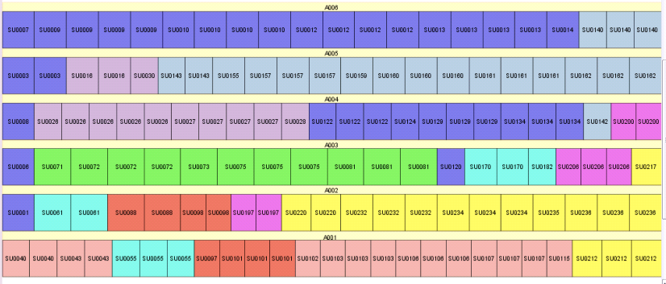
Importance of Detailed Constraints and Multiple Objectives
Solution to the left is optimized considering all goals.
The solution below is set just to maximize profit.
However, you can see that product families are not laid out next to each other or in neat configurations.
There is a hidden assumption: to sell products, consumers have to find them
Solution Considering all Goals
Solution To Maximize Profit
Source: IBM

Slide 41
End of Section

